Slide 1
Exploring Collection of Social Media data as a method of identifying PMC Wagner Activity
Jason Driscoll, ECON 8320

Slide 2
AGENDA
Objective
Methods
Obstacles
Revised Methods
Data Cleaning
Results
Continuation

Slide 3
Objective
Investigate the collection and analysis of data from the internet, and social networking in particular, as methods of augmenting traditional data sources in evaluating the probability of PMC Wagner operating in a specific geographic region.

Slide 4
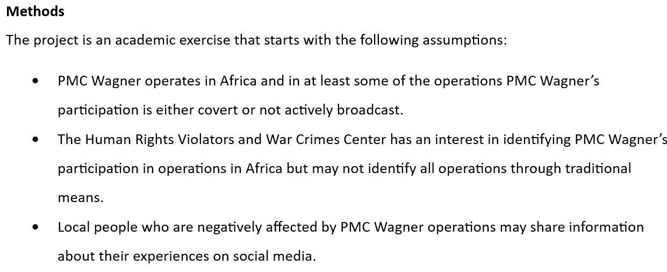
Relevant Assumptions

Slide 5
Methods
Step 1 – collect Twitter data from defined geographic regions.
Step 2 – complete analysis using NLP tools available in Python.
Step 3 – provide visualizations of cumulative numbers, polarity and subjectivity of tweets within various geographic regions.

Slide 6
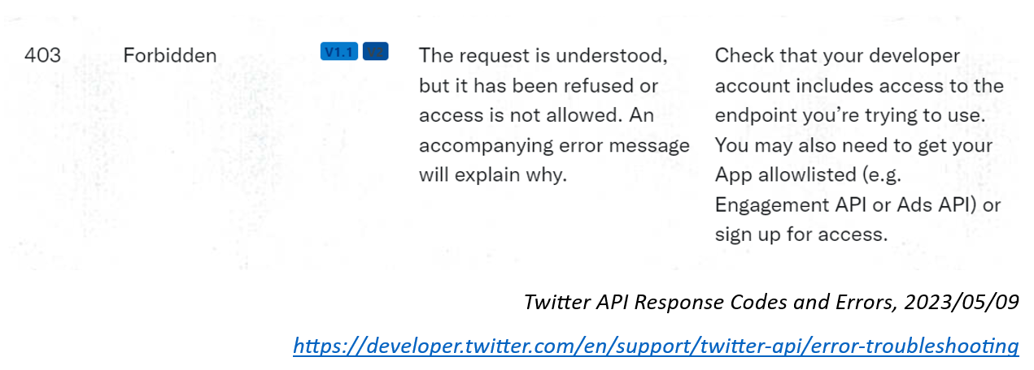
Obstacles
Twitter API 403 Errors
Account Access Issues
Bing is Dumb and Mean and has Few Results

Slide 7
Obstacles Continue
Recent Twitter Changes
Account Upgrades
The place.fields Fiasco

Slide 8
Andrew Edward is a hero
An Extensive Guide to Collecting Tweets from Twitter API v2 for Academic Research Using Python 3, Towards Data Science,
Guidance and templating for successful API requests.
Results obtained: 2607
Relevant Results after Cleaning: 563

Slide 9
Cleaning
Size of data set causes problems with NLP
Reduced size by selecting subset of relevant tweets
NLP was much happier
Tools for Polarity and Subjectivity run successfully

Slide 10
Results
1
Proper Nouns
2
Cumulative Mentions
3
Polarity
4
Subjectivity

Slide 11
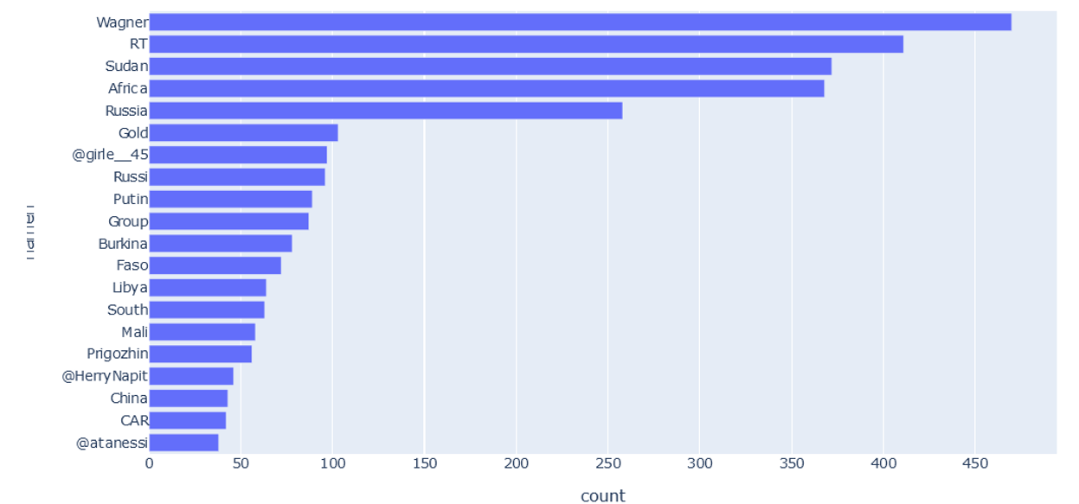
Results

Slide 12
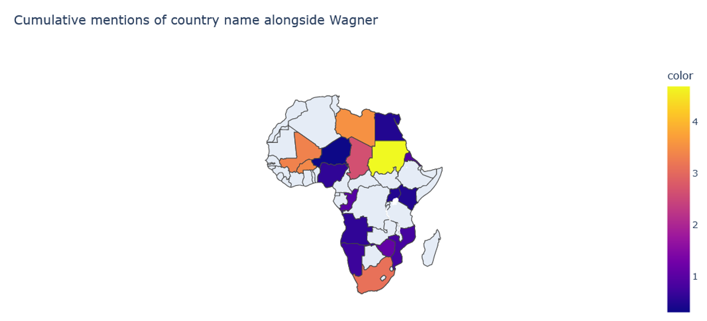
Results

Slide 13
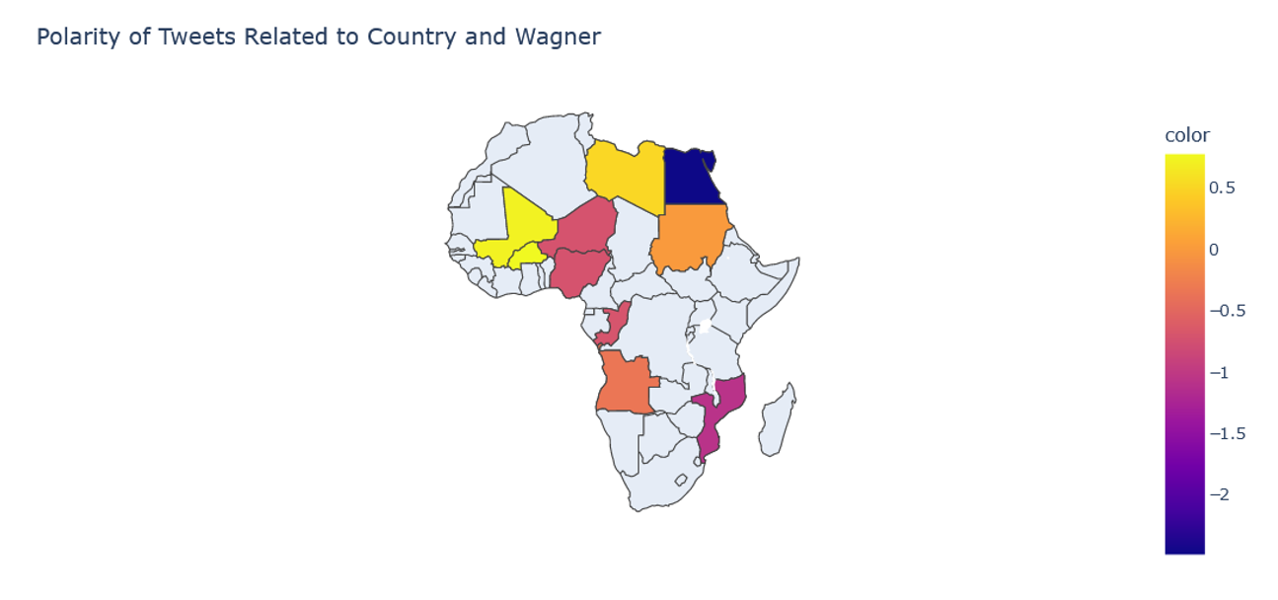
Results

Slide 14
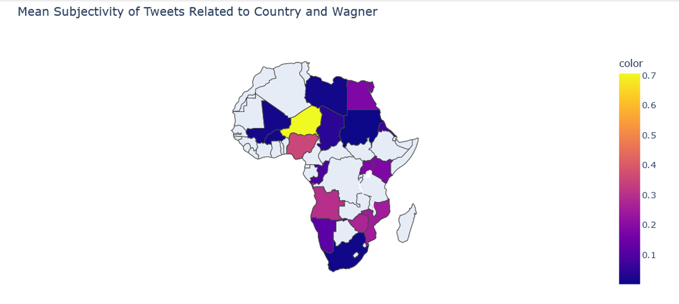
Results

Slide 15
Continuation
Fix Access Issues
Use Change-Over-Time
Gain access to geographic info.
​Gain access to full archive searches.
Broader time frame enables meaningful analysis of changes.
Visualizing change in cumulative total, polarity, subjectivity more in line with original proposal.

Slide 16
Work Cited
#Edward, Andrew (2021, Jun 13) An Extensive Guide to collecting tweets from Twitter API v2 for
#academic research using Python 3. Towards Data Science.
#https://towardsdatascience.com/an-extensive- guide-to-collecting-tweets-from-twitter-api-v2- for-academic-research-using-python-3- 518fcb71df2a

